Slide 1
C++ Part II
X52.9265-01
Yedidiah Solowiejczyk
Week#3
New York University
School
of
Professional and Continuous Studies
3/15/11
C++ Part II

Slide 2
Synopsis
Overloading Basics
  Overloading Basics
  Overloading Binary Operators (e.g. X + Y, X * Y, etc)
  Returning by const Value
  Overloading Unary Operators (+X, -X, X++, ++X, etc)
  Overloading as Member Functions
  Overloading as Global and friend functions
  Overloading the arithmetic , ++/--, [ ], =, ( ), etc operators
  Overloading >> and <<
Automatic Type Conversion
  Constructors for Automatic Type Conversion
  Friend Functions
  Friend Classes
Overloading the new and delete operators
Example; Overloading operators in Rational Number Class
3/15/11
C++ Part II

Slide 3
Basic Operator Overload
Arithmetic Operations involving +, -, * , etc on well-defined types (int, float, double, etc)
  Are really just function calls with different syntax and distinct arguments
Example:
int x, y;
float z, w;
x + y; // compiler invokes ALU
z + x; // compiler invokes FPU
Alternate function definitions:
IntAdd ( int x, int y ); // ALU returns x + y
FloatAdd (float z, float w); // FPU returns z + w
+(int x, int y); // “+” is function name
etc
3/15/11
C++ Part II

Slide 4
Basic Operator Overload
Operator overloads for built-in types
  int: x + y, x * y, x / y, etc // compiler understands
  float: a + b, a * b, a / b, etc
  double: U + V, U* V, U / V, etc
Operator overloads for defined classes
  Complex: U + V, U*V, U/V, etc ➔ might make sense
    Complex Number ➔ Real + j Imag
  Rational: Q + R, Q*R, Q/R, ect ➔ might make sense
    Rational ➔ Numerator/Denominator
  Student: X + Y ➔ ( The birth of another student ???)
  Shape: Shape1 + Shape2 ➔ Shape 3 (larger ???)
3/15/11
C++ Part II

Slide 5
Overloading Basics
Overloading operators
  Very similar to overloading functions
  operator@ itself is "name" of function
    where @ - represents the operator that is being overloaded
Example Declaration for Rational class :
Rational operator*( const Rational& rhs);
  Overloads “*” for operands of type Rational
    Allows multiplication of ”Rational" objects
      X1 * X2; //i.e. multiply of rational numbers
      X1.operator*(const Rational & X2);
    Uses constant reference parameters for efficiency
    Returned value is type Rational
3/15/11
C++ Part II

Slide 6
Overloading Basics
Use of Overloaded operators
    Simplifies arithmetic manipulations of distinct objects
      Complex Numbers
        +, -, *, /
        e.g. Z = X * Y { ( Xr*Yr – Xi*Yi), (Xr*Yi + Yr*Xi) }
      Rational Numbers
        +, -, *, /
        e.g. R = Q * P { ( Q_{num} * P_{num}), (( Q_{denum} * P_{denum})
      Strings
        +
        e.g. S3 = S1 + S2 {concatenate S2 onto S1)
      Matrices
      +, -, *, 1.0/M (Matrix Inverse)
      e.g. M3 = M1* M2 {matrix multiply – row*col dot products)
3/15/11
C++ Part II

Slide 7
Select Rational Number as Candidate Object
FPGAs (Field programmable gate arrays ) are considered to be an excellent computational raw engines for hardwired DSP.
Modern FPGA devices provide millions of configurable gates, and millions bits of built in memories, which can operate at frequencies up to hundreds of MHz.
FPGA platforms, intended for DSP applications, provide tenths and hundreds of islands, each of them has hardware multiplier and long product accumulator. As a result, such an FPGA calculator has the peak throughput more than 100 billion OPS.
Linear algebra problem solving becomes the important task of the modern DSP applications. They are adaptive filtering, curve interpolation, system parameter estimation, signal back propagation problem solving, rigid body dynamic modeling, image improvement and others.
Such problem solving affords high precision calculations. Therefore it is usually implemented using single and double precision floating point numbers. That is why linear algebra problems are usually solved only in PC and floating point DSP microprocessors.
Modern high volume FPGAs give the opportunity to build the highly pipelined floating point ALUs with double precision. FPGAs can provide the very precise fixed point number representation up to hundreads of bits.
Rational Numbers do not need to use any division algorithm…!!!!
3/15/11
C++ Part II
8

Slide 8
Review of Rational Arithmetic
Rational X1 ➔ (Num1, Den1) ➔ Num1/Den1
Rational X2 ➔ (Num2, Den2) ➔ Num2/Den2
Product: Z = X1 * X2
(Num1*Num2) , (Den1*Den2)
Quotient: Z = X1 / X2
(Num1*Den2), (Den1*Num2) - No division algorithm needed
Sum: Z = X1 + X2
(Num1*Den2 + Num2*Den1), (Den1*Den2)
Difference: Z = X1 - X2
(Num1*Den2 - Num2*Den1), (Den1*Den2)
Relational & Equality
X1 > X2; X1 >= X2; X1 == X2; X1 != X2;
Unary
X1++; ++X1; X1--; --X1;
All of the above calculations should be reduced with their GCD
  Greatest Common Divisor (GCD) – Reduce( ) algorithm
3/15/11
C++ Part II

Slide 9
Review of Rational Arithmetic
Rational arithmetic operators can be implemented by either of these 3 methods:
  Global operator overloaded functions
    X1+X2; //sum of two rational objects
    Rational operator+(const Rational& lhs, const Rational& rhs);
  Member operator overloaded functions
    X1*X2; //product of two rational objects
    Rational operator*(const Rational& rhs);
    X1.operator*(X2);
  Friend operator overloaded functions
    5 + X1; // sum of integer and rational object
    friend Rational operator+(const int lhs, const Rational& rhs)
  Compiler will find correct match and execute appropriate operator overloaded function call
3/15/11
C++ Part II

Slide 10
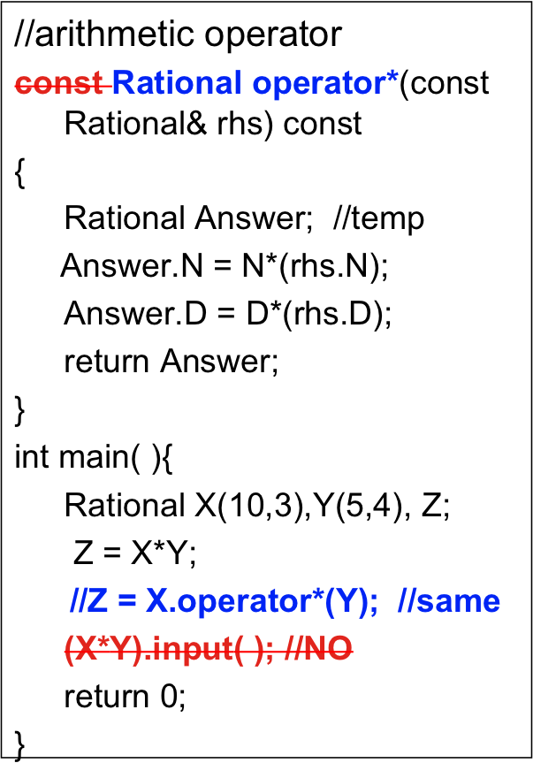
Binary Overloaded “*"
Default constructor
class Rational{
private:
int N;
int D;
public:
//constructors
Rational( ):N(0), D(1){ }
Rational(int n, int d):
N(n), D(d){ }
Rational(const & rhs):
N(rhs.N), D(rhs.D) { }
//destructor
~Rational( ){ }
Default constructor
Destructor
&
Copy constructor
3/15/11
C++ Part II

Slide 11
Binary Overloaded “*”
Return Optimization
class Rational{
private:
int N;
int D;
public:
//constructors
Rational( ):N(0), D(1){ }
Rational(int n, int d):
N(n), D(d){ }
Rational(const & rhs):
N(rhs.N), D(rhs.D) { }
//destructor
~Rational( ){ }
//arithmetic operator
Rational operator*(const Rational& rhs) const
{
int Num = N*(rhs.N);
int Denum = D*(rhs.D);
return Rational(Num, Denum);
}
int main( ){
Rational X(10,3),Y(5,4), Z;
Z = X*Y;
//Z = X.operator*(Y); //same
return 0;}
Saves copy constr & destructor
Default constructor
Compiler builds object directly into location of return requiring only one constructor
3/15/11
C++ Part II

Slide 12
GCD & Rational Numbers
Rational X1(4, 16);
Rational Y1(8, 32);
Effectively X1 and Y1 are equal if we bother to calculate the GCD on both numbers.
GCD calculations should be implemented on all Rational numbers at
  Creation
  Upon entering a function call
  Improves dynamic range of possible Rational Numbers
Two primary GCD algorithms
  Euclidean algorithm
  Stein’s (binary) algorithm
A GCD( ) member function should be included in class definition – however in private section (only for internal use)
3/15/11
C++ Part II

Slide 13
Summary of Rational Overloaded Operators
Rational X, Y; //declare rationals
Binary Operations
  X + Y, X – Y, X * Y, X / Y, X % Y, X & Y, X | Y, X ^ Y
  X + int, X – int, X*int, X/int and int + X, int – X, int*X, int/X
Assignment Operations
  X = Y, X +=Y, X -=Y, X *=Y, X /=Y, X %= Y, X &= Y, X |= Y, X ^= Y
Unary Operations
+X, -X, ++X, X++, --X, X--, !X, ~X
Relational Operations
X == Y, X != Y, X > Y, X >= Y, X < Y, X <= Y
3/15/11
C++ Part II

Slide 14
General Overloadable Operators
Binary:
+, -, *, /, %, ^, &, |
Assignment:
=, +=, -=, *=, /=, %=, &=, |=, ^=
Unary:
-, +, ++, --, !, ~
Relational:
<, <=, >, >=, ==, !=
Logical:
&&, ||
General:
[ ], ( ), ->, ->*, new, delete
3/15/11
C++ Part II

Slide 15
Assignment operator=()
class Rational{
private:
int N;
int D;
public:
//constructors
Rational( ):N(0), D(1){ }
Rational(int n, int d):
N(n), D(d){ }
Rational(const & rhs):
N(rhs.N), D(rhs.D) { }
//destructor
~Rational( ){ }
};
//assignment operator
const Rational & operator=(const Rational& rhs)
{
if(this != &rhs){
N = rhs.N;
D = rhs.D;}
return *this;
}
int main( ){
Rational X(10,3),Y(5,4), Z;
Z = (X = Y); //OK
Z = Z; //OK
//(X = Y).input( ); //NO
return 0;}
Default constructor
3/15/11
C++ Part II

Slide 16
Assignment operator*=()
class Rational{
private:
int N;
int D;
public:
//constructors
Rational( ):N(0), D(1){ }
Rational(int n, int d):
N(n), D(d){ }
Rational(const & rhs):
N(rhs.N), D(rhs.D) { }
//destructor
~Rational( ){ }
};
//assignment operator
const Rational & operator+=(const Rational& rhs)
{
N = rhs.N;
D = rhs.D;
return *this;
}
int main( ){
Rational X(10,3),Y(5,4), Z;
Z *= Y;
//Z.operator*=(Y);
return 0;
}
Default constructor
3/15/11
C++ Part II

Slide 17
Equality operator==()
class Rational{
private:
int N;
int D;
public:
//constructors
Rational( ):N(0), D(1){ }
Rational(int n, int d):
N(n), D(d){ }
Rational(const & rhs):
N(rhs.N), D(rhs.D) { }
//destructor
~Rational( ){ }
};
//equality operator
int operator==(const Rational& rhs)
{
return(N * rhs.D == D * rhs.N);
}
int main( ){
Rational X(10,3),Y(5,4), Z;
int flag = (X == Y); //OK
return 0;
}
Default constructor
3/15/11
C++ Part II

Slide 18
Prefix operator++()
class Rational{
private:
int N;
int D;
public:
//constructors
Rational( ):N(0), D(1){ }
Rational(int n, int d):
N(n), D(d){ }
Rational(const & rhs):
N(rhs.N), D(rhs.D) { }
//destructor
~Rational( ){ }
};
//prefix ++ operator
const Rational & operator++( )
{
N += D;
return *this;
}
int main( ){
Rational X(10,3), Z;
Z = ++X; //OK
// ++(++X); //NO
return 0;
}
Default constructor
3/15/11
C++ Part II

Slide 19
Postfix operator++(int)
class Rational{
private:
int N;
int D;
public:
//constructors
Rational( ):N(0), D(1){ }
Rational(int n, int d):
N(n), D(d){ }
Rational(const & rhs):
N(rhs.N), D(rhs.D) { }
//destructor
~Rational( ){ }
};
//prefix ++ operator
const Rational operator++( int)
{
Rational Temp = *this;
N += Denom;
return Temp;
}
int main( ){
Rational X(10,3), Z;
Z = X++; //OK
// (X++)++; //NO
return 0;
}
Default constructor
flag
3/15/11
C++ Part II

Slide 20
Index operator( )
class Rational{
private:
int N;
int D;
public:
//constructors
Rational( ):N(0), D(1){ }
Rational(int n, int d):
N(n), D(d){ }
Rational(const & rhs):
N(rhs.N), D(rhs.D) { }
//destructor
~Rational( ){ }
const int Rational::operator( )
(int value);
}
//operator( )
const int Rational::operator( )(int value)
{
switch(value){
case 1:
return num;
break;
case 2:
return denum;
break;
default:
cout << "wrong " << endl;
break; }
}
int main( ){
Rational X(10,3), Z;
int Num = X(1);
int Den = X(2);
return 0;
}
Default constructor
3/15/11
C++ Part II

Slide 21
Unary Overloaded Operators
// Rational X;
// +X;
// Y = +X;
const Rational & Rational::operator+( ) const
{
return *this; // putting a + of a rational number does not change it
}
// -X
Y = -X;
Rational Rational::operator-( ) const
{
return Rational( -num, denom );
}
3/15/11
C++ Part II

Slide 22
Chaining Binary Operators
Candidates
  X + Y, X – Y, X * Y, X / Y ➔ Binary Arithmetic Operations
  X & Y, X | Y, X ^ Y ➔ Binary Bitwise Operators
  X % Y ➔ Binary Modulus Operator
Properties
  Obey the associative law of arithmetic
  e.g.
    X + Y + Z ➔ (X + Y) + Z // associates L-R
    (X.operator +(Y) ).operator(Z)
  Assignment operator obeys the associative law
  e.g. X = ( Y = Z); Return value should be const
Marginally Useful for Rational Numbers
3/15/11
C++ Part II

Slide 23
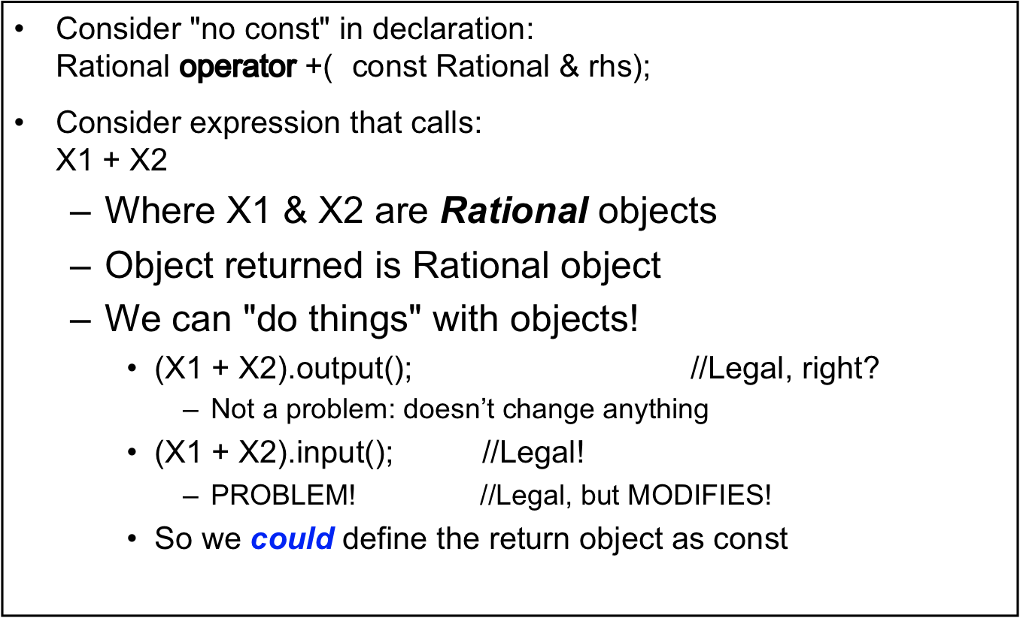
Returning by non-const Value
3/15/11
C++ Part II

Slide 24
Overloaded Equality/Relational Operators
Candidates
  X == Y, X != Y ➔ Equality Operators
  X > Y, X >= Y ➔ Relational Operators
  X < Y, X <= Y
Properties
  Equality/Relational operators cannot be chained
  e.g. ( X == Y); // Returns bool(int)
  e.g. (X > Y); //Returns bool(int)
3/15/11
C++ Part II

Slide 25
Friend functions
A friend function is used for accessing the non-public members of a class.
  Has all the privileges of member function
A class can allow non-member functions and other classes to access its own private data, by making them friends.
  Thus, a friend function is an ordinary function or a member of another class.
  Declare friend function only inside class declaration
  Friend functions do not have access to this pointer
3/15/11
C++ Part II

Slide 26
Friend functions
// Rational-integer operators:
Z = X*5;
Z = 5*X;
Class Rational{
::::::::::::::::
public:
Rational operator*(const int);
friend Rational operator*(const int, const Rational &);
};
//Definition
Rational Rational::operator*(const int x){ // member function
int Num = num * x;
return Rational(Num, denum);
}
Rational operator*(const int x, const Rational & rhs) //non-member function {
int Num = x* rhs.num;
return Rational(Num, rhs.denum);
}
3/15/11
C++ Part II

Slide 27
Overloading >> and <<
Enables input and output of our objects
  Similar to other operator overloads
  float X = 5.5;
  cout << “X = “, << X << endl;
Improves readability
  Like all operator overloads do
  Enables:
  cout << Object; ➔ Not Object.output( )
  cin >> Object; ➔ No Object.input( )
3/15/11
C++ Part II

Slide 28
I/O Overloaded Operators
class Rational{
private:
int num;
int denum;
public:
//Output Overloaded Operator
friend ostream & operator<<(ostream & out, const Rational & Rhs);
};
ostream & operator<<(ostream & out, const Rational & Rhs)
{
out << Rhs.N << " / " << Rhs.D << " ”;
return out;
}
int main( )
{
Rational X(1,3);
cout << “X = “ << X << endl;
}
cout object, of class type ostream
3/15/11
C++ Part II

Slide 29
friend Classes
When you want to expose the private member data or functions to another class, you declare the class to be a friend
To declare a friend class in another class requires the
use of a forward definition:
Example:
class F; //forward declaration
class C{
public:
::::::
friend class F;
};
class F{
::::::
};
3/15/11
C++ Part II

Slide 30
friend class
using namespace std;
class X {
  int a, b;
  friend class F;
  public:
  X() : a(1), b(2) { }
};
class F {
public:
void print(X& x) { cout << "a is " << x.a << endl; cout << "b is " << x.b << endl; }
};
int main() {
X xobj;
F fobj;
fobj.print(xobj);
}
a is 1
b is 2
3/15/11
C++ Part II

Slide 31
Data Type Conversion
What happens when you want to assign an int to a Rational object ???
class Rational{
int N;
int D;
public:
Rational( ):N(0), D(1){}
//int constructor
Rational(int value): N(value),D(10{ }
~Counter( ){} //destructor
};
void foo(Rational Z);
int main( ){
int Value = 5;
Rational X = Value;
cout << “X = “ << X << endl;
foo(X); //std call
foo(Value); // data conversion
}
void foo(Rational Z)
{
cout << “foo” << endl;
}
Automatic type conversion
3/15/11
C++ Part II

Slide 32
Conversion Operators
What happens when you want to assign an int to a Rational object ???
class Rational{
int N;
int D;
public:
Rational( ):N(0), D(1){}
Rational(int n, int d):N(n),D(d){ }
operator float( ){
return float(N)/float(D);
}
~Counter( ){} //destructor
};
int main( )
{
Rational X(9,4);
float U = X;
cout << “U = “ << U << endl;
}
U = 2.25
With constructor conversion, the destination class performs conversion
With operator conversion the source class performs the conversion
3/15/11
C++ Part II

Slide 33
Guidelines for Overloading Operators
Operator | Recommended Use
All Unary Operators +, -, ++, --, ~,, !, & | Member
=, ( ), [ ], ->, ->* | Must be member
+=, -=, *=, /= &=, |=, %= <<=, >>= | Member function
All other binary Operators | Member, friend, global
(.), ::, sizeof, ?:, .*, #, ##, ** | Cannot be overloaded
3/15/11
C++ Part II

Slide 34
Overloading Summary
The number of arguments in an overloaded operator’s argument list depends on two factors:
  Operator defined as a Global (friend) function
    Unary – one argument
    Binary – two arguments
  Operator defined as Member function
    Unary - Zero arguments
    Binary (one argument and object becomes left-hand argument)
3/15/11
C++ Part II

Slide 35
Overloading new & delete
When you create an object using new two things occur
  The memory is allocated using operator new
  Then the constructor is called
When you destroy an object two things occur
  Destructor is called
  Memory is deallocated using operator delete
Typically constructor and destructor are never under your control
3/15/11
C++ Part II

Slide 36
Overloading new & delete
Standard new and delete have been designed for general-purpose use
For situations where many objects are being created and destroyed, bottlenecks and fragmentation might be created by such scenarios
C++ allows the new and delete operators to be overloaded
  operator new( )
  operator delete( )
3/15/11
C++ Part II

Slide 37
Overloading new & delete
operator new( ) and operator delete( ) change only the way raw storage is allocated
  Compiler will invoke user-defined new instead of default new and then invoke the constructor
There are various scenarios for overloading new and delete operator:
  Overloading global new & delete
    Drastic approach
  Overloading new & delete for a class
    Large pool of memory is created to hold an array of objects
  Overloading new & delete for arrays
    Only one constructor and destructor are invoked
  Placement new & delete
    Placing object in specific location
3/15/11
C++ Part II

Slide 38
Overloading global new & delete
This is the drastic version where your overload the global versions of new and delete
  void * operator new(size_t sz )
  void operator delete(void *)
The default new and delete are completely inaccessible
The argument to new (size_t sz) is generated by the compiler and is the size of object you are trying to create
void* is the return value of operator new( )
  Gets the pointer after constructor is called
void is the return value of operator delete( )
  Gets the pointer after destructor is called
3/15/11
C++ Part II

Slide 39
Overloading global new & delete
#include <stdio.h>
#include <stdlib.h>
void * operator new(size_t sz){ //compiler generated
printf("Operator new: %d Bytes\n", sz);
void* m = malloc(sz);
if(m == NULL)
printf("Out of Memory\n");
return m;
}
void operator delete(void* m){
printf("Operator delete\n");
free(m);
}
class S{
int i[100]; //contains some internal data
public:
S( ){printf("Default constructor\n");}
~S( ) {printf("Destructor\n");}
};
int main( ) {
printf(”Creating and destroying an int\n");
int *p = new int(47); //init value to 47
delete p;
printf("Creating and destroying s\n");
S *s = new S;
delete s;
printf("Creating and destroying S[3]\n");
S *sa = new S[3];
delete [ ]s;
}/*********************** Results ************************/
./New_Global
Crating and destroying an int
Operator new: 4 Bytes
Operator delete
Creating and destroying s
Operator new: 400 Bytes
Default constructor
Destructor
Operator delete
Creating and destroying S[3]
Operator new: 1204 Bytes
Default constructor
Default constructor
Default constructor
Destructor
Destructor
Destructor
Operator delete
3/15/11
C++ Part II

Slide 40
Overloading new & delete for a class
A particular strategy that can be exploited when working with array of objects that need to be dynamically allocated is to create a pool of memory in the static data area at program startup and that memory is used to allocate space for objects using overloaded operator new( ) that works in conjunction with that pool.
class X{ …… };
int main( ){
X* X_ptr[N]; // declare array of pointers to X
for(i = 0; i < N; i++)
X_ptr[i] = new X; //overloaded new operator
} // maps each X_ptr[i] to distinct blocks
// in static data area – reduces overhead
// cost of allocation & fragmentation
3/15/11
C++ Part II

Slide 41
Overloading new & delete for a class
#include <stdio.h>
class X{
enum {sz = 10};
char c[sz];
static unsigned char pool[ ]; //mem pool
static bool alloc_map[ ];
public:
enum{ psize = 5};
X( ) {printf("Default constructor\n");}
~X( ){printf("Destructor\n");}
void* operator new(size_t);
void operator delete(void *);
};
//create pool of memory
unsigned char X::pool[psize * sizeof(X)];
bool X::alloc_map[psize] = {false};
void* X::operator new(size_t sz) { //size ignored
for(int i = 0; i < psize; i++)
if(!alloc_map[i]){
printf("using block %d ....\n", i);
alloc_map[i] = true; // mark it used
return pool + (i * sizeof(X) );
}
}
void X::operator delete(void *m){
if(!m) return; //Check for NULL Pointer
// Assume it was created in the pool
// Calculate block #
unsigned long block = (unsigned long)m - (unsigned long)pool;
block /= sizeof(X);
printf("Freeing Block %d\n", block);
alloc_map[block] = false; // Mark it free
}
int main( ){
X* X_ptr[X::psize]; //array of pointers
int i;
int j;
for(i = 0; i < X::psize; i++) {
X_ptr[i] = NULL;
X_ptr[i] = new X;
if(X_ptr == NULL){
printf("Out of Memory\n"); }
}
delete X_ptr[4]; //arbitrary deallocate
X_ptr[4] = 0;
for(j = 0; j < X::psize; j++)
delete X_ptr[j]; //delete X[4] OK
}
3/15/11
C++ Part II

Slide 42
Overloading new & delete for a class
int main( ){
X* X_ptr[X::psize];
int i;
int j;
for(i = 0; i < X::psize; i++) {
X_ptr[i] = NULL;
X_ptr[i] = new X;
if(X_ptr == NULL){
printf("Out of Memory\n");
}
}
delete X_ptr[2]; //arbitrary deallocate
X_ptr[2] = 0;
for(j = 0; j < X::psize; j++)
delete X_ptr[j]; //delete X[4] OK
}
/************************** Results ******************/
/New_Class
using block 0 ....
Default constructor
using block 1 ....
Default constructor
using block 2 ....
Default constructor
using block 3 ....
Default constructor
using block 4 ....
Default constructor
Destructor
Freeing Block 2
Destructor
Freeing Block 0
Destructor
Freeing Block 1
Destructor
Freeing Block 3
Destructor
Freeing Block 4
3/15/11
C++ Part II

Slide 43
Overloading new & delete for arrays
The strategy for dynamically allocating an array of objects can be enhanced via overloaded new/delete operators
  The overloaded new() operator is called to allocate enough storage for the array all at once.
  Likewise the overloaded operator delete( ) is called to release the storage
  You can control the allocation of arrays by overloading the special versions of
    operator new[ ]
    operator delete[ ]
3/15/11
C++ Part II

Slide 44
Overloading new & delete for arrays
#include <stdio.h>
#include <new>
class X{
enum {sz = 10};
int i[sz];
public:
X( ) {printf("*Default constructor\n");}
~X( ){printf("~Destructor\n");}
void* operator new(size_t sz)
{
printf("X::new: %d Bytes\n", sz);
return ::new char[sz]; //get chunk of mem
}
void operator delete(void* p){
printf("X::delete\n");
::delete [ ]p;
}
//Size is ignored - assume object X
void* operator new[ ](size_t sz) {
printf("X::new: %d Bytes\n", sz);
return ::new char[sz];
}
void operator delete[ ](void* p){
printf("X::delete[] : \n");
::delete [ ]p;
}
};
int main( ){
printf("New X\n");
X* X_ptr = new X;
printf("Delete X\n");
delete X_ptr;
printf("\nnew X[5]\n");
X_ptr = new X[5];
printf("\ndelete []X\n");
delete [ ]X_ptr;
}
/************************** Results ***************************
/New X
X::new: 40 Bytes
*Default constructor
Delete X
~Destructor
X::delete
new X[5]
X::new: 204 Bytes
*Default constructor
*Default constructor
*Default constructor
*Default constructor
*Default constructor
delete []X
~Destructor
~Destructor
~Destructor
~Destructor
~Destructor
X::delete[] :
3/15/11
C++ Part II

Slide 45
Summary
C++ operators are really just functions
C++ built-in operators can be overloaded
  To work with objects of your class
Operators can be overloaded as member functions
  1st operand is calling object
Friend functions have direct private member access
3/15/11
C++ Part II

Slide 46
Summary
Friend functions add efficiency only
  Not required if accessors/mutators are available
C++ can overload <<, >>
  Return type is a reference to stream type
Operators that can overloaded:
  +, -, *, /, %, =, ==, ++, --, new, delete, etc
Operators that cannot be overloaded
  (.), ::, sizeof, ?:, etc
3/15/11
C++ Part II

